Slide 1
B-Trees
Large degree B-trees used to represent very large dictionaries that reside on disk.
Smaller degree B-trees used for internal-memory dictionaries to overcome cache-miss penalties.
Notes:
May also be used internally to reduce cache misses and hence improve performance.

Slide 2
AVL Trees
n = 2³⁰ = 10⁹ (approx).
30 <= height <= 43.
When the AVL tree resides on a disk, up to 43 disk access are made for a search.
This takes up to (approx) 4 seconds.
Not acceptable.
Notes:
43 cache misses possible when searching memory resident AVL trees

Slide 3
Red-Black Trees
n = 2³⁰ = 10⁹ (approx).
30 <= height <= 60.
When the red-black tree resides on a disk, up to 60 disk access are made for a search.
This takes up to (approx) 6 seconds.
Not acceptable.

Slide 4
m-way Search Trees
Each node has up to m – 1 pairs and m children.
m = 2 => binary search tree.

Slide 5
4-Way Search Tree
10 30 35
k < 10
10 < k < 30
30 < k < 35
k > 35

Slide 6
Maximum # of Pairs
Happens when all internal nodes are m-nodes.
Full degree m tree.
# of nodes = 1 + m + m² + m³ + … + m^{h-1}
= (m^{h} – 1)/(m – 1).
Each node has m – 1 pairs.
So, # of pairs = m^{h} – 1.

Slide 7
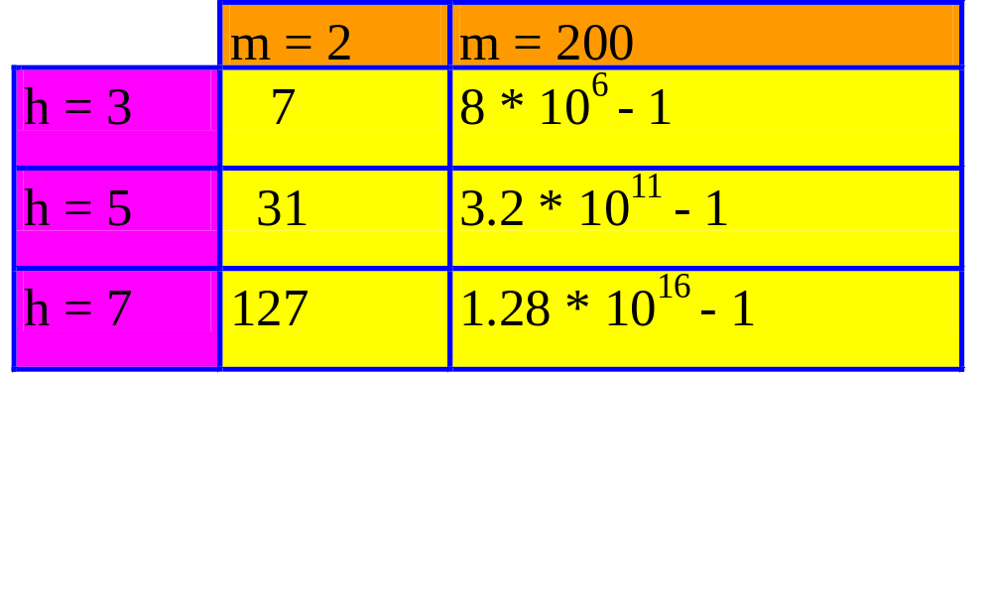
Capacity of m-Way Search Tree
Notes:
Natural extension of 2-3 and 2-3-4 trees would leave worst case at m=2.

Slide 8
Definition of B-Tree
Definition assumes external nodes (extended m-way search tree).
B-tree of order m.
  m-way search tree.
  Not empty => root has at least 2 children.
  Remaining internal nodes (if any) have at least ceil(m/2) children.
  External (or failure) nodes on same level.
Notes:
Alternative definition has pairs only in leaves; remaining nodes have keys only. Leaf-pushed B-tree or B+-tree.

Slide 9
2-3 and 2-3-4 Trees
B-tree of order m.
  m-way search tree.
  Not empty => root has at least 2 children.
  Remaining internal nodes (if any) have at least ceil(m/2) children.
  External (or failure) nodes on same level.
2-3 tree is B-tree of order 3.
2-3-4 tree is B-tree of order 4.

Slide 10
B-Trees of Order 5 And 2
B-tree of order m.
  m-way search tree.
  Not empty => root has at least 2 children.
  Remaining internal nodes (if any) have at least ceil(m/2) children.
  External (or failure) nodes on same level.
B-tree of order 5 is 3-4-5 tree (root may be 2-node though).
B-tree of order 2 is full binary tree.
Notes:
Not possible for an internal node in an extended tree to have only 1 child.

Slide 11
Minimum # of Pairs
n = # of pairs.
# of external nodes = n + 1.
Height = h => external nodes on level h + 1.
level
# of nodes
1
1
2
>= 2
3
>= 2*ceil(m/2)
h + 1
>= 2*ceil(m/2)^{h-1}
n + 1 >= 2*ceil(m/2)^{h-1}, h >= 1

Slide 12
Minimum # of Pairs
n + 1 >= 2*ceil(m/2)^{h-1}, h >= 1
m = 200.
height
# of pairs
2
>= 199
3
>= 19,999
4
>= 2 * 10⁶ – 1
5
>= 2 * 10⁸ – 1
h <= log _{ceil(m/2)} [(n+1)/2] + 1

Slide 13
Choice of m
Worst-case search time.
  (time to fetch a node + time to search node) * height
  (a + b*m + c * log₂m) * h
    where a, b and c are constants.
search time
50
400
m
Notes:
Typically pick m so as to fill a block.

Slide 14
Insert
8
4
15 20
1 3
5 6
9
16 17
30 40
Insertion into a full leaf triggers bottom-up node splitting pass.
Notes:
2-3 Tree. Insert 10, no problem. Insert 18?

Slide 15
Split an Overfull Node
m a₀ p₁ a₁ p₂ a₂ … p_{m} a_{m}
a_{i} is a pointer to a subtree.
p_{i} is a dictionary pair.
ceil(m/2)-1 a₀ p₁ a₁ p₂ a₂ … p_{ceil(m/2)-1} a_{ceil(m/2)-1}
m-ceil(m/2) a_{ceil(m/2)} p_{ceil(m/2)+1} a_{ceil(m/2)+1} … p_{m} a_{m}
p_{ceil(m/2)} plus pointer to new node is inserted in parent.
Notes:
Node Splitting

Slide 16
Insert
8
4
15 20
1 3
5 6
9
16 17
30 40
Insert a pair with key = 2.
New pair goes into a 3-node.

Slide 17
Insert into a Leaf 3-node
Insert new pair so that the 3 keys are in ascending order.
1 2 3
Split overflowed node around middle key.
2
1
3
Insert middle key and pointer to new node into parent.
Notes:
The code will do all 3 steps as one.

Slide 18
Insert
8
4
15 20
1 3
5 6
9
16 17
30 40
Insert a pair with key = 2.

Slide 19
Insert
8
4
2
15 20
3
1
5 6
9
16 17
30 40
Insert a pair with key = 2 plus a pointer into parent.

Slide 20
Insert
8
2 4
15 20
1
3
5 6
9
16 17
30 40
Now, insert a pair with key = 18.

Slide 21
Insert into a Leaf 3-node
Insert new pair so that the 3 keys are in ascending order.
16 17 18
Split the overflowed node.
17
16
18
Insert middle key and pointer to new node into parent.

Slide 22
Insert
8
2 4
15 20
1
3
5 6
9
16 17
30 40
Insert a pair with key = 18.

Slide 23
Insert
8
17
2 4
15 20
18
1
3
5 6
9
16
30 40
Insert a pair with key = 17 plus a pointer into parent.

Slide 24
Insert
8
17
2 4
15
20
1
3
5 6
9
16
18
30 40
Insert a pair with key = 17 plus a pointer into parent.

Slide 25
Insert
8 17
2 4
15
20
1
3
5 6
9
16
18
30 40
Now, insert a pair with key = 7.

Slide 26
Insert
8 17
6
2 4
15
20
7
1
3
5
9
16
18
30 40
Insert a pair with key = 6 plus a pointer into parent.

Slide 27
Insert
8 17
4
6
2
15
20
5
7
1
3
9
16
18
30 40
Insert a pair with key = 4 plus a pointer into parent.

Slide 28
Insert
8
4
17
2
6
15
20
1
3
5
7
9
16
18
30 40
Insert a pair with key = 8 plus a pointer into parent.
There is no parent. So, create a new root.

Slide 29
Insert
8
4
17
2
6
15
20
1
3
5
7
9
16
18
30 40
Height increases by 1.

